Slide 1

Monitoring a MICROSERVICES
web application using Prometheus and Grafana
Jordi Ruiz
Fullstack Developer, Mercuria Energy S.A.
Notes:
Hello everyone and welcome to this talk: “Monitoring a MICROSERVICES web application using Prometheus and Grafana”. As you can see the word MICROSERVICES is highlighted but at the same time is completely redundant. I could have name this talk Monitoring a web application using Prometheus and Grafana and still makes sense. But it is not the same, I am sure that instead of having a room full of people I would have had 4 o 5 people, most of them the guys that work with me, maybe Pau the organizer and someone else that came for the beers. Let’s be honest, people have better things to do, I don’t know maybe install the latest JavaScript Framework or refresh Twitter every 5 seconds. But because I have added the word MICROSERVICES, that change the game. You feel that you cannot miss this talk or you are out of the wave. Although, you can come here and just download the lastest Javascript Framework and refresh Twitter every 5 seconds.

Slide 2
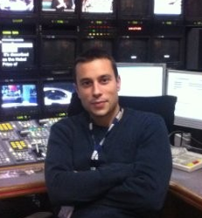
BIO
Jordi Ruiz Jiménez
FULLSTACK developer
https://www.linkedin.com/in/jordiruizj/
https://twitter.com/jruizx
https://github.com/jruizx
Notes:
Who am I? My name is Jordi Ruiz and I am FULLSTACK developer based in London. Again, I have highlighted Fullstack in bold and uppercase, and exactly for the same reason, because is trending, nothing else. I could have said that I am a developer, but it sounds a bit like I am loser. You put on your linkedin that you are developer and no one contact you. On the other hand, you put that you are a fullstack developer and I can guarantee you that every couple of days you receive a message from a recruiter. Which they are quite annoying… However I quite like to see notifications on my phone. It looks like I have some friends and a exciting social life. Jokes apart, I think you title is very important, but I have to give you a bad news. It doesn’t matter how hard you work, or how important is the job you are doing, the best title ever has already been assigned.

Slide 3


Slide 4

WHERE DO I WORK?
Notes:
So as I said I am a fullstack developer, basically I do C# using the new dotnet core framework and javascipt using the Angular framework and I do my work on this company called Mercuria. Mercuria is a energy and commodity trading company based in Geneva, Switzerland. Our team is quite distributed around the world. I am working in London, there are people working in Geneva, there are people working in Barcelona, one working in France, another in Singapur and we even have one guy working in the most remote place that you can imagine, Dos Hermanas, Seville… So it is quite challenging working remotely but so far so good. By the way we are hiring!!! So if any of you guys are looking for new challenges please let us know, or send us a CV.

Slide 5
WHERE DO I WORK?
WE ARE HIRING

Slide 6
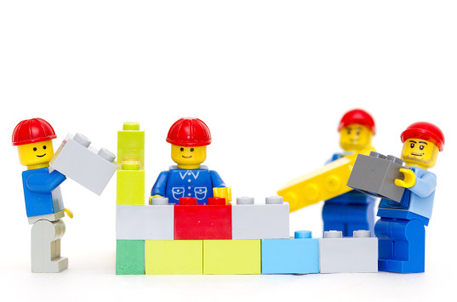
THE PROJECT
Notes:
A year ago, more or less, we started a project to put some governance to all the back office processes in Mercuria, everything except the trading business: Recruiting, Hiring, Legal processes, accounting, IT, Taxes, subscriptions, and so on. I would describe this as a ginormous project. From the beginning we knew that we were going to deal with a complex Domain for our solution. So we decided to apply Domain Driven Design in order to tackle the complexity.

Slide 7

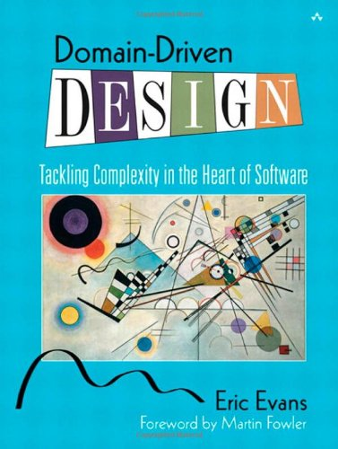
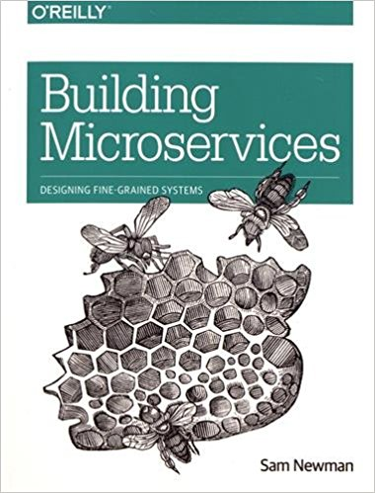
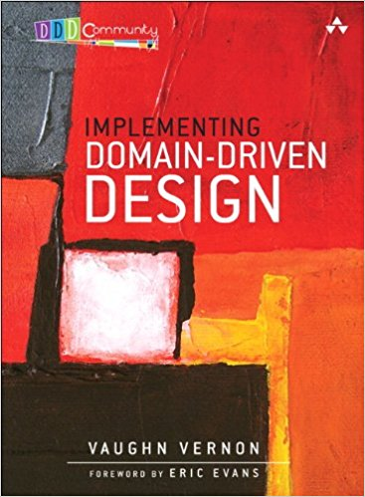

THE PROJECT
Notes:
We had read a few books about Domain Driven Design, Microservices and good development practices like TDD or eXtreme Programming. So we felt a bit like Don Quixote, crazy enough to start our project and kill the giants. So we started defining some aggregates, entities, repositories, services, etc. inside of a bounded context that eventually would be deployed as an isolated micro service.

Slide 8

Notes:
OK, this is an interesting slide. As I mentioned before I work remotely and sometimes I work from home. But my house is not so big (you know London prices…) so my 3 years old daughter is always around and she loves to interrupt me. So one day I was preparing this PowerPoint and she came and asked me:
Papi what are you doing?
I have to put some images to talk in front of people and tell them what I am working on
Why don’t you explain Peppa Pig?
I cannot do that.
Please, Papi, everyone loves Peppa Pig
OK, I will do that if you let me work for two hours.
And here we are. So this is Daddy Pig, Mummy Pig, Peppa and George.
We felt a bit like them jumping up and down in muddy puddles when we started our new Greenfield project.

Slide 9

WORKING H ARD
Notes:
So, we worked really hard and in a few months we had our business experts defining functionality using amazing wireframes, our developers had built a nice Continuous Integration system on top of Gitlab, with a nice pipeline that build our solution, execute some tests, and deployed everything inside of Docker containers. So testers, domain experts, and stakeholders could navigate to our application built with angular and dotnet core and start giving us priceless feedback. They were happy days, but suddenly…

Slide 10
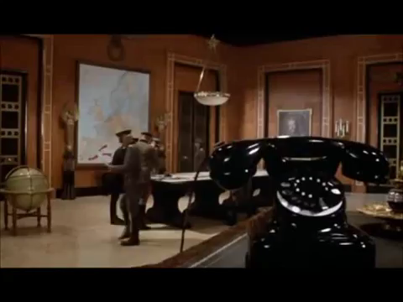
Notes:
We received a phone call from our Project Director, let’s call him Mr. S.
Hello guys, I have done a few demos to some departments and they love the solution that we are building.
Yeah that’s amazing!
So we have to start planning the production environment and open it to people.
What?!!??

Slide 11

Notes:
So we were panicking for a while, but our technical lead, let’s called him Mr. D. came with a few motivational sentences from I guess Paulo Coelho or some kind of cheap business school. The typical this is not a problem this is an opportunity to shine. This is what we have been waiting, etc. So we arrange a technical meeting and decided what we need to put our solution in production. During this meeting someone suggested that we needed some kind of monitoring system to check the health of our solution. In this kind of meeting you feel like you have to say something and because I was quiet during the meeting suddenly my brain had some kind of shortcut and I said OK, I can do that. Even though I never had implemented any kind of monitoring system. So after the meeting I did what any decent person would have done.

Slide 12
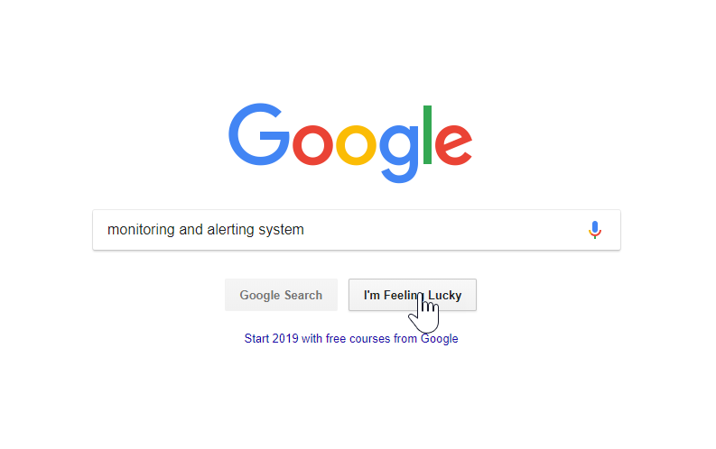
Notes:
Hold on a second, I think this is the second thing I did. The first thing I did was to look for what the hell monitoring means…

Slide 13
MONITORING
monitoring
​present participle of monitor
monitor verb [ T ]
UK ​ /ˈmɒn.ɪ.tə^{r}/ US ​ /ˈmɑː.nə.t̬ɚ/
​to watch and check a situation carefully for a period of time in order to discover something about it:
The new findings suggest that women ought to monitor their cholesterol levels.
The CIA were monitoring his phone calls.
Notes:
I came with the Cambridge Dictionary definition. “To watch and check a situation carefully for a period of time in order to discover something about it”. This definition is so interesting and it is what we wanted to do. Check our system for a period of time to check if it was behaving properly. Anyway, after a few searches in google and reading a bit in Stackoverflow, I don’t think I went to the second page in Google, I discovered an open source solution that is being adopted for many companies and organizations in our industry. I would like to welcome Prometheus!

Slide 14

Notes:
Sorry, just before to introduce Prometheus, this is Suzy Sheep, Peppa’s best friend. So now, PROMETHEUS!

Slide 15

PROMETHEUS
Notes:
Prometheus is a monitoring system. It collects metrics from configured targets at given intervals, evaluates rule expressions, display the results, and can trigger alerts if some condition is observed to be true.

Slide 16
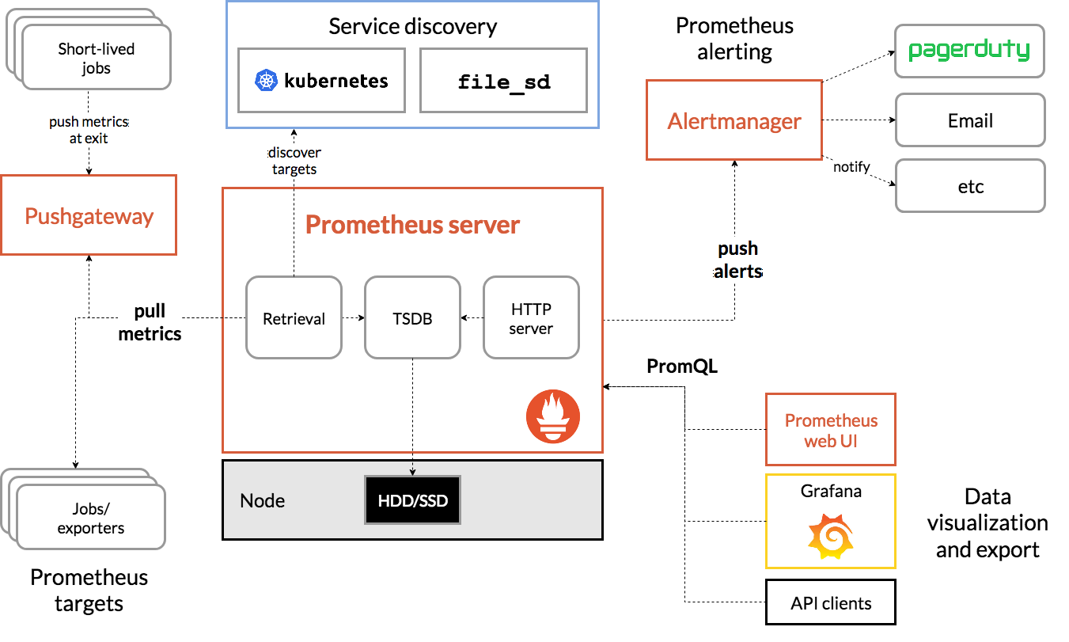
PROMETHEUS ARCHITECTURE
Notes:
Prometheus collect metrics from job exporters, either directly o via a intermediary push gateway, I have never used this pushgateway, so please don’t ask any questions about it. It store all this data that collects locally and runs rules over this data to aggregate or generate alerts. We can use Prometheus web UI to visualize this data or we can use data visualization tools like grafana. Let’s give a nice welcome to Grafana, Prometheus best friend.

Slide 17

GRAFANA
Notes:
Grafana is an open source, feature rich metrics dashboard and graph editor for Graphite, Elasticsearch, OpenTSDB, Prometheus and InfluxDB.

Slide 18
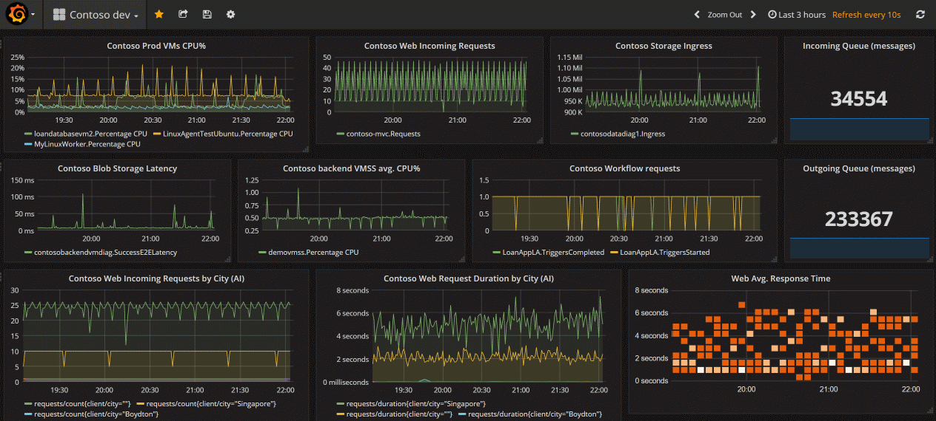
GRAFANA EXAMPLE
Notes:
One of the key points of adopting Grafana is how easy is to build a spot on dashboard. Basically you add one or several panels, each of one configured with one datasource, in our case always Prometheus as Datasource, and chose which kind of chart do you want and the query to obtain the data from the datasource. But we will see a bit more in a few minutes.

Slide 19

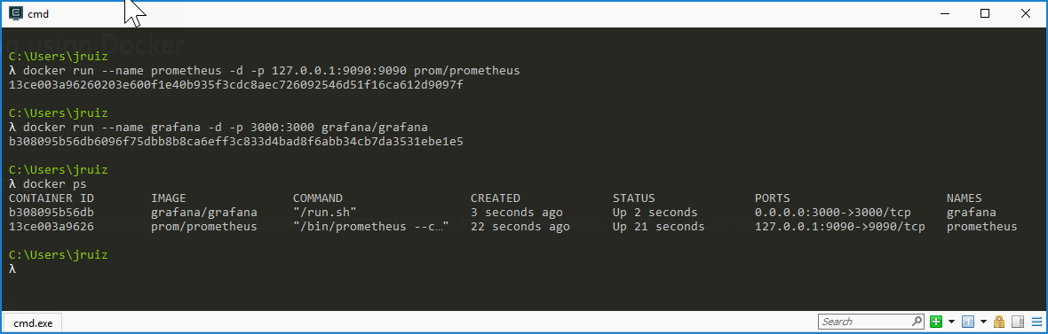
INSTALLING EVERYTHING WE NEED
Notes:
Now that the introductions have made and they are almost members of our family. Let’s see how we can install and configure every component. For that we are going use Docker. As we know we could first pull the image and the run the container or we can do both things at the same time. So in order to install Prometheus we should execute the following command: docker run --name prometheus -d -p 127.0.0.1:9090:9090 prom/Prometheus and we do the same iin order to install grafana: docker run -d -p 3000:3000 grafana/grafana

Slide 20

WAKE UP!
IS DEMO TIME!

Slide 21

Notes:
This is Madame Gazelle. Peppa’s teacher. Let’s see know how to configure Prometheus to collect information from the exporters.

Slide 22
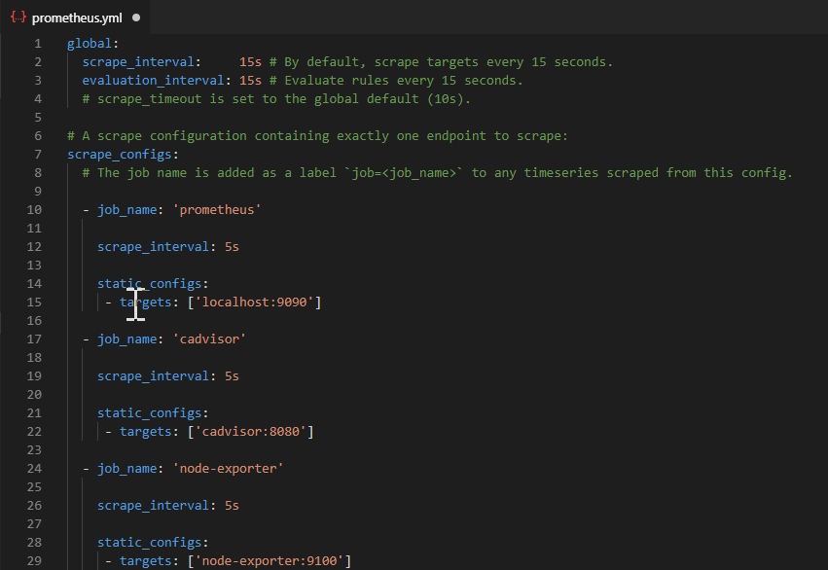
CONFIGURING PROMETHEUS
Notes:
We can configure Prometheus using a yml file. In this yml file we can specify things like how often we want to scrape information and the jobs or exporters for these metrics. Every exporter is define as a job, with a name and basically the endpoint to obtain the data. In our example we can see that we have define 3 jobs / exporters: Prometheus itself, cadvisor, that can give us information about the containers and node-exporter, that can give us information about the container’s host.

Slide 23

WHAT SHOULD I MONITOR?
Notes:
Ok, we know that we have a system that can collect metrics. The next clever question to ask ourselves is what should I monitor? The short answers is you should monitor everything. Every library, subsystem and service should have at least a few metrics to give us some rough idea of what is going on. Now you can think OMG that could be a full time job if I have to write exporters for everything that we are using. Fortunately, there is a huge community and software vendors that are building exporters to be used or to be integrated with Prometheus. So you should only focus on building the metrics for your own software. Let’s see a list of this exporters, shall we?

Slide 24
List of exporters

Slide 25
Cadvisor and node exporter

Slide 26
Demo cadvisor and exporter

Slide 27
Configure alertmanager

Slide 28
Configure alert rules

Slide 29
Demo about alerts

Slide 30
Configure grafana

Slide 31
Demo create a dashboard

Slide 32
Create our own exporter

Slide 33
Demo all together

Slide 34
Thank you

Slide 35
Questions

Slide 36
One more thing… buy this book

